Slide 1
Introduction to Data Science
Thulasyammal Ramiah Pillai
School of Computer Science and Engineering
Faculty of Innovation and Technology
Taylor’s University

Slide 2
OUTLINE
Data All Around
Data Science
Introduction
Why Data Science
Data Scientists
What do they do?
Processes in Data Science

Slide 3




Data All Around
Lots of data is being collected and warehoused
Web data, e-commerce
Financial transactions, bank/credit transactions
Online trading and purchasing
Social Network

Slide 4
Big Data
Big Data is any data that is expensive to manage and hard to extract value from
Volume
The size of the data
Velocity
The latency of data processing relative to the growing demand for interactivity
Variety and Complexity
the diversity of sources, formats, quality, structures.

Slide 5
What is Data Science?
An area that manages, manipulates, extracts, and interprets knowledge from tremendous amount of data
Data science (DS) is a multidisciplinary field of study with goal to address the challenges in big data
Data science principles apply to all data – big and small

Slide 6
What is Data Science?
Theories and techniques from many fields and disciplines are used to investigate and analyze a large amount of data to help decision makers in many industries such as science, engineering, economics, politics, finance, and education
Computer Science
Pattern recognition, visualization, data warehousing, High performance computing, Databases, AI
Mathematics
Mathematical Modeling
Statistics
Statistical and Stochastic modeling, Probability.

Slide 7
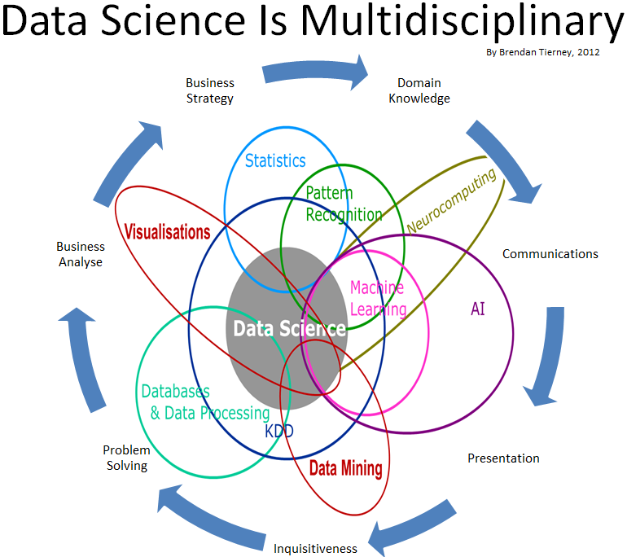
Data Science

Slide 8
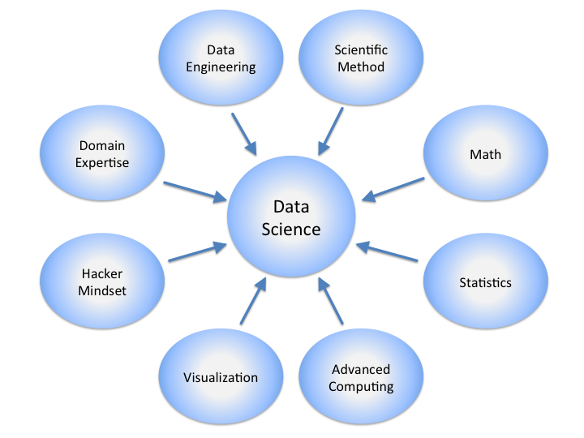
Data Science

Slide 9
Real Life Examples
Companies learn your secrets, shopping patterns, and preferences
For example, can we know if a woman is pregnant, even if she doesn’t want us to know? Target case study
Data Science and election (2008, 2012)
1 million people installed the Obama Facebook application that gave access to info on “friends”

Slide 10

Data Scientists
Data Scientist
The Sexiest Job of the 21st Century
They find stories, extract knowledge. They are not reporters

Slide 11

Data Scientists
Data scientists are the key to realizing the opportunities presented by big data. They bring structure to it, find compelling patterns in it, and advise executives on the implications for products, processes, and decisions

Slide 12
What do Data Scientists do?
National Security
Cyber Security
Business Analytics
Engineering
Healthcare
And more ….

Slide 13
Concentration in Data Science
Mathematics and Applied Mathematics
Applied Statistics/Data Analysis
Solid Programming Skills (R, Python, Julia, SQL)
Data Mining
Data Base Storage and Management
Machine Learning and discovery

Slide 14
Processes in Data Science
AI Deep Learning
A/B Testing, Experimentation, Simple Machine Learning Algorithm
Analytics, Metrics, Segments, Aggregates, Features, Training Data
Cleaning, Anomaly Detection, Preparation
Reliable Data Flow, Infrastructure, Pipelines, ETL, Structured and unstructured data storage
Instrumentation, logging, sensors, external data, user generated content

Slide 15
Data Science Related Jobs
AI/DL DS Core/ML Engineer
ML (DS)
Data Analytics (DS)
Explore/Transform (Data Engineer )
Move/Store (Data Engineer)
Data Collection (Software Engineer)

Slide 16
Data Science Processes
1. Business Problems
Why?
When?
2. Data Acquisition
Web servers
Databases
Data Cleaning
Transformation
What?
Who?
Where?
3. Data Preparation
Online repositories
4. Exploratory Data Analysis
Feature Extraction
Feature Selection
5. Model Development
KNN
Decision Tree
Naive Bayes
6. Visualization and Communication
tableau
ggplot package
7. Deploys and Maintain
Testing
Validation
Improvement

Slide 17
THANK
YOU
ENJOY
YOUR
CLASS

